Slide 1
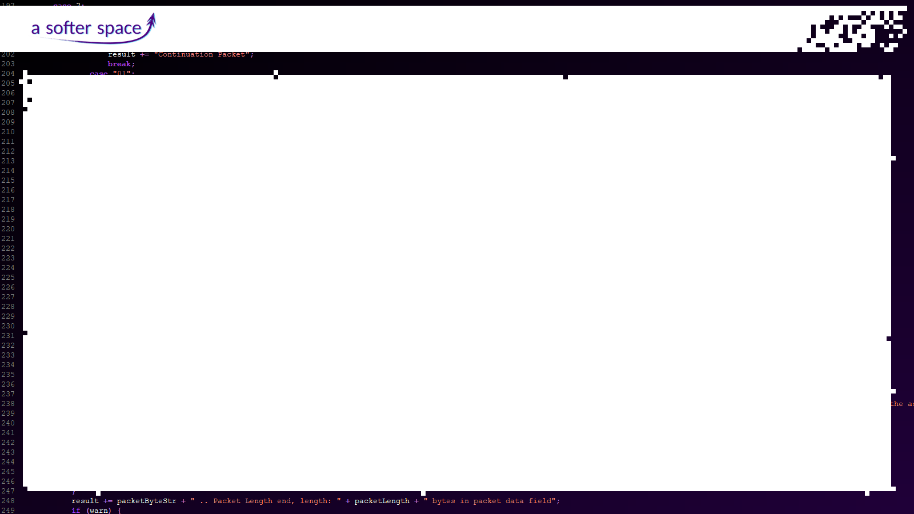
Dev Funk
How about not repeating
the same mistakes again and again?
Tom Moya Schiller
A Softer Space
BMT
January 2020

Slide 2
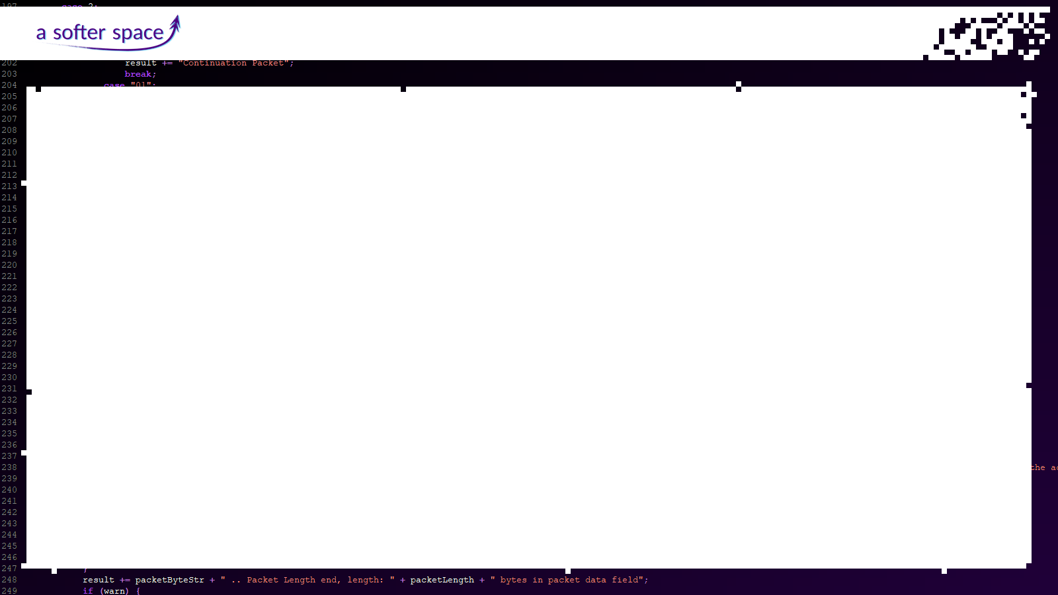
Dev Funk – How about not repeating the same mistakes again and again?
Let us look at a few topics surrounding software development…
And how to not repeat the same mistakes all over again :3

Slide 3
Dev Funk – How about not repeating the same mistakes again and again?
Software Project Management

Slide 4
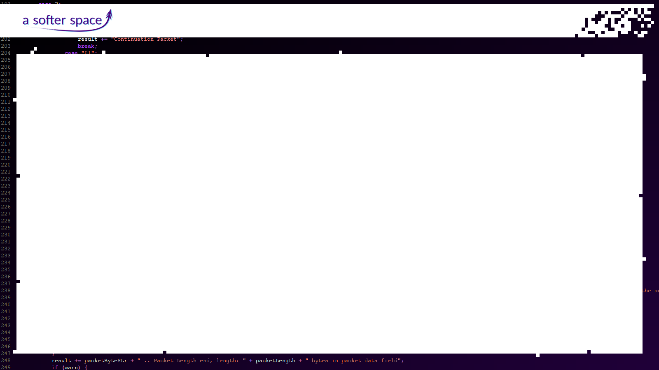
Dev Funk – How about not repeating the same mistakes again and again?
Ever planned a large-scale software project?

Slide 5
Dev Funk – How about not repeating the same mistakes again and again?
Ever planned a large-scale software project?
“We will have the new delivery by christmas!”
“Great! In which year?”

Slide 6
Dev Funk – How about not repeating the same mistakes again and again?
Ever planned a large-scale software project?
“We will have the new delivery by christmas!”
“Great! In which year?”
Adding manpower to a late software project makes it later.
~ Frederick Brooks

Slide 7
Dev Funk – How about not repeating the same mistakes again and again?
Personal experience:
large software project split across many different teams
no access to integrated system, teams working on components in isolation
components designed “on paper” (many PDFs!)
⇒ no interactive system available to see how users would react
users not involved at all
prototype of full system intended to be created, but did not work
⇒ however, this caused no consequences / changes in design

Slide 8
Dev Funk – How about not repeating the same mistakes again and again?
Instead: Explorative Development System for large software projects
team of six¹ highly skilled people work on it for a year
team writes documentation using a wiki while building a real functioning prototype of the software that is intended to be the skeleton for future work
⇒ allows skilled team to identify and solve the hard problems early
only when prototype is successfully running, give out parts to contractors
⇒ by now it is clear which parts actually make sense
1: https://www.quora.com/What-is-the-typical-team-size-for-a-software-development-project

Slide 9
Dev Funk – How about not repeating the same mistakes again and again?
ideally, go through this process with several teams at the same time
teams completely independent, choosing own technology baselines
in the end, several prototype skeletons available
⇒ involve users in choosing which one to use

Slide 10
Dev Funk – How about not repeating the same mistakes again and again?
Uncanny Valley for Software

Slide 11
Dev Funk – How about not repeating the same mistakes again and again?
Ever heard of the Uncanny Valley?

Slide 12
Dev Funk – How about not repeating the same mistakes again and again?

Slide 13
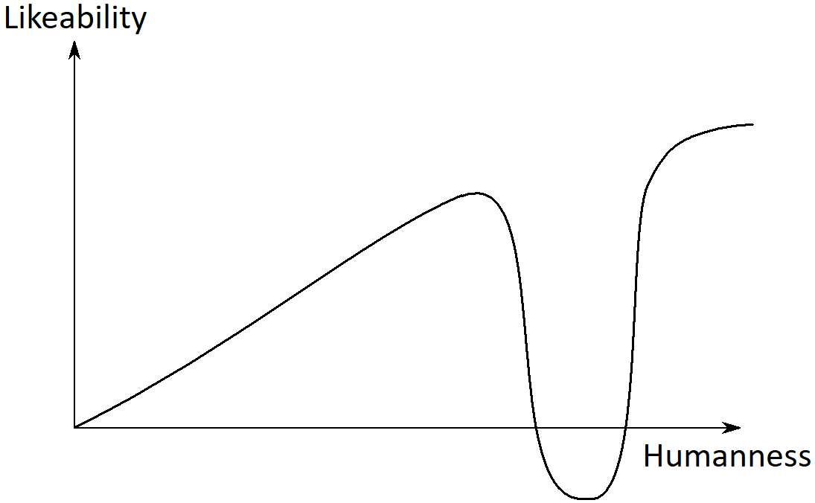
Dev Funk – How about not repeating the same mistakes again and again?

Slide 14
Dev Funk – How about not repeating the same mistakes again and again?
How does this relate to software?

Slide 15
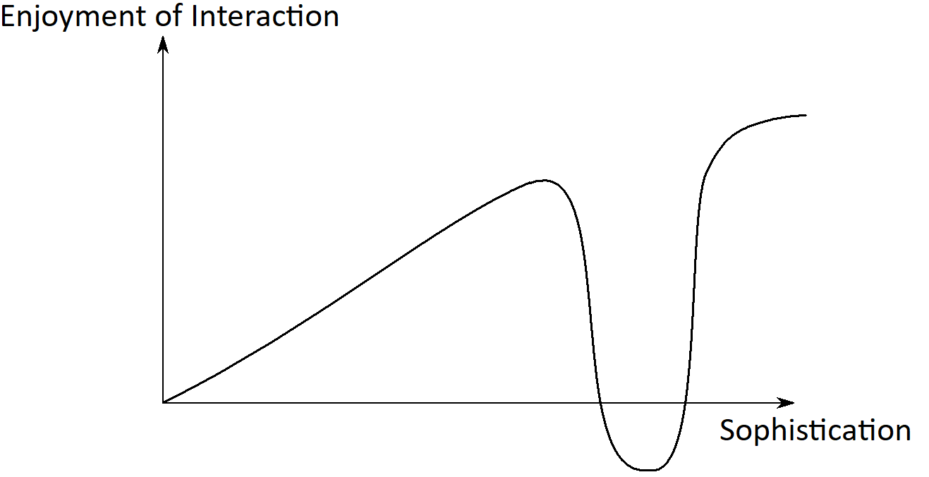
Dev Funk – How about not repeating the same mistakes again and again?

Slide 16
Dev Funk – How about not repeating the same mistakes again and again?
So we can learn:
if your program is simple, it will be perceived as reliable, understandable and users enjoy using it
if your program is more complex, trying to solve problems too well, it will go wrong every once in a while and users will get annoyed
you can either be simple and reliable, or really perfect, but trying-too-hard while not-quite-there is the worst…

Slide 17
Dev Funk – How about not repeating the same mistakes again and again?
Dependencies

Slide 18
Dev Funk – How about not repeating the same mistakes again and again?
Dependencies:
can speed up creation of your application
can keep complexity within your own code minimal
⇒ make it more secure and maintainable
fine line between this – and utter chaos:
⇒ code from who knows where suddenly pops up
⇒ no one dares touching existing dependencies

Slide 19
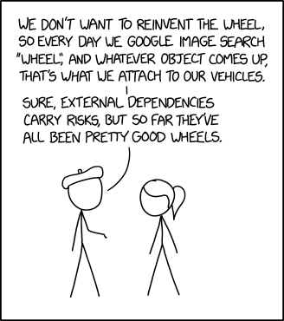
Dev Funk – How about not repeating the same mistakes again and again?
https://xkcd.com/2140/

Slide 20
Dev Funk – How about not repeating the same mistakes again and again?
It’s harder to read code than to write it.
~ Joel Spolsky
Use dependencies – not to make your life easier now,
but to make it easier in the future!

Slide 21
Dev Funk – How about not repeating the same mistakes again and again?
Dependencies should:
Actually benefit you
Be released under a suitable software license
Be actively maintained
Be built on mature technology
Not drag in lots more dependencies
Have useful documentation

Slide 22
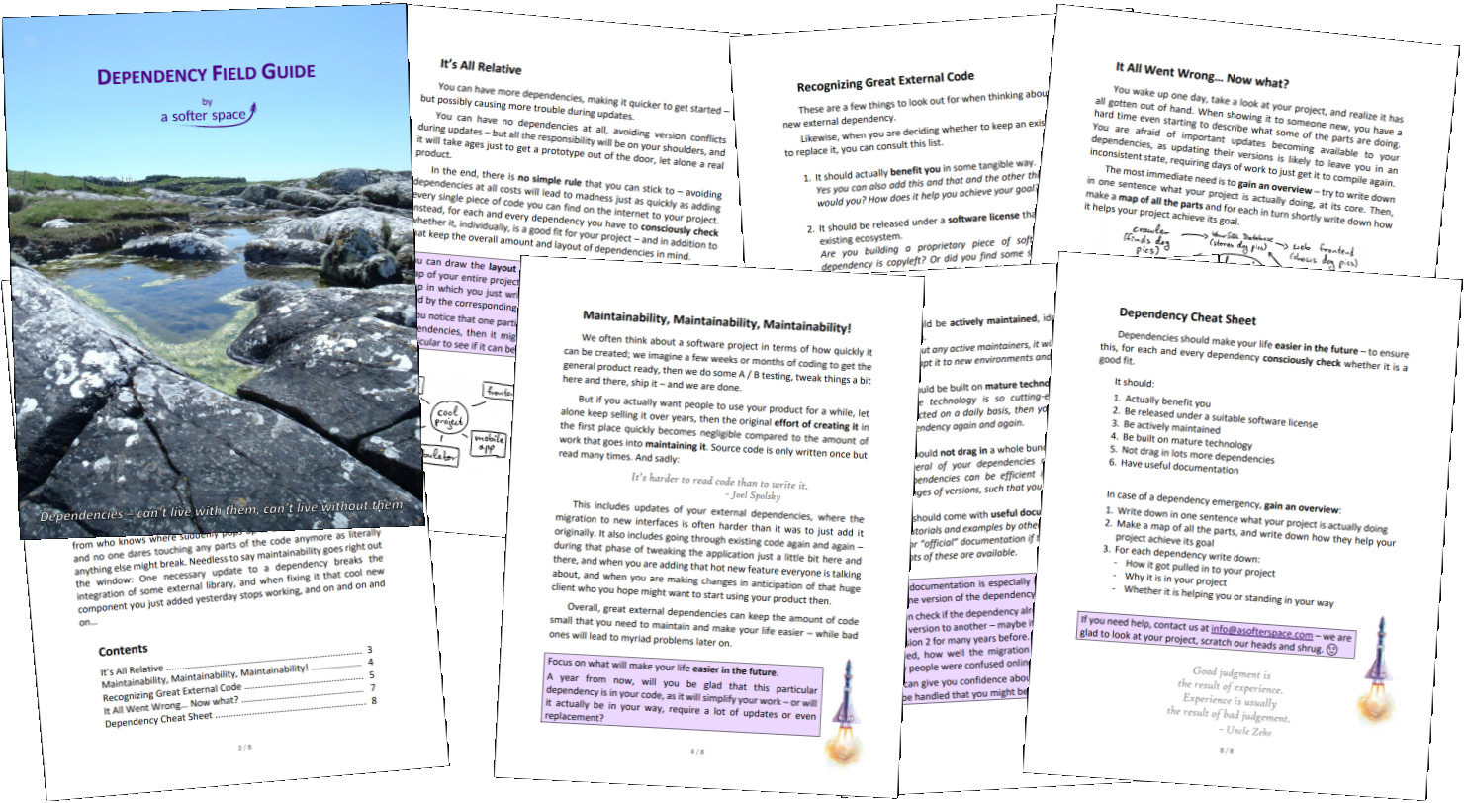
Dev Funk – How about not repeating the same mistakes again and again?
For more such nonsense, see our Dependency Field Guide! :D
https://www.asofterspace.com/tools/dependencyFieldGuide

Slide 23
Dev Funk – How about not repeating the same mistakes again and again?
Good judgment is the result of experience.
Experience is usually the result of bad judgement.
~ Uncle Zeke

Slide 24
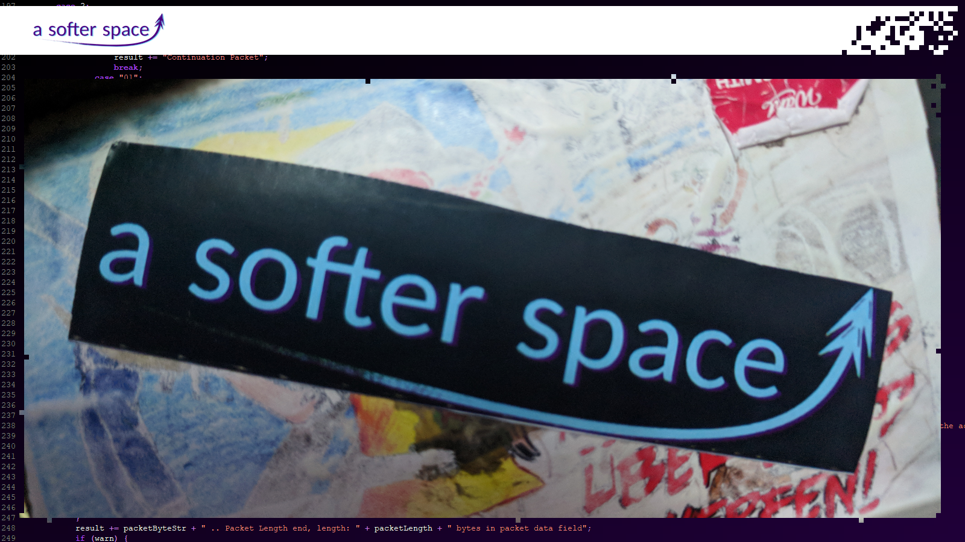
Dev Funk – How about not repeating the same mistakes again and again?

